Slide 1
Basic Accounting Concepts Principles and Procedures, 2nd Edition, Volume 1

Slide 2
Learning Goals 12 - 16

Slide 3
Review: In our prior discussion we saw that accounting can be described as a three-stage process, and can be illustrated like this:
The Three Stage Process of Accounting
Analyze Event
(Transaction)
Record and Process
Data From the Event
• Create,
• Communicate, • Interpret
Financial
Information
To analyze, we use the accounting equation and apply. After analysis, we record each transaction using a system of columns and left/right rules for the transactions.
For the third stage, to communicate the results of recording the transactions, we use the data from the recording process to prepare financial statements. Financial statements provide the essential financial information about an organization to those people who need that information.

Slide 4
What Are The Financial Statements?
The four required general-purpose financial statements:
1. An income statement reports revenues and expenses, showing the difference as profit or loss (“net income” or “net loss”) over a period of time. The time period usually ends on the same date as the balance sheet.
2. A statement of owner's equity reports the beginning and ending balances of owner's equity and shows the changes in owner's equity over a period of time. The time period is normally the same as the income statement and ends on the balance sheet date.

Slide 5
The four required general-purpose financial statements, continued
A balance sheet is the most fundamental financial statement. It is based on the accounting equation and reports assets, liabilities, and owner's equity as of a specific date. In other words, it shows the business wealth and the claims on that wealth as of a point in time.
4. A statement of cash flows reports the beginning and ending cash balances, and explains the changes in cash over a period of time. The time period is normally the same as the income statement and ends on the balance sheet date.
These are general purpose financial statements prepared for general use by any stakeholder – an owner, manager, investor, lender, or anyone with a financial interest in the reporting organization.

Slide 6
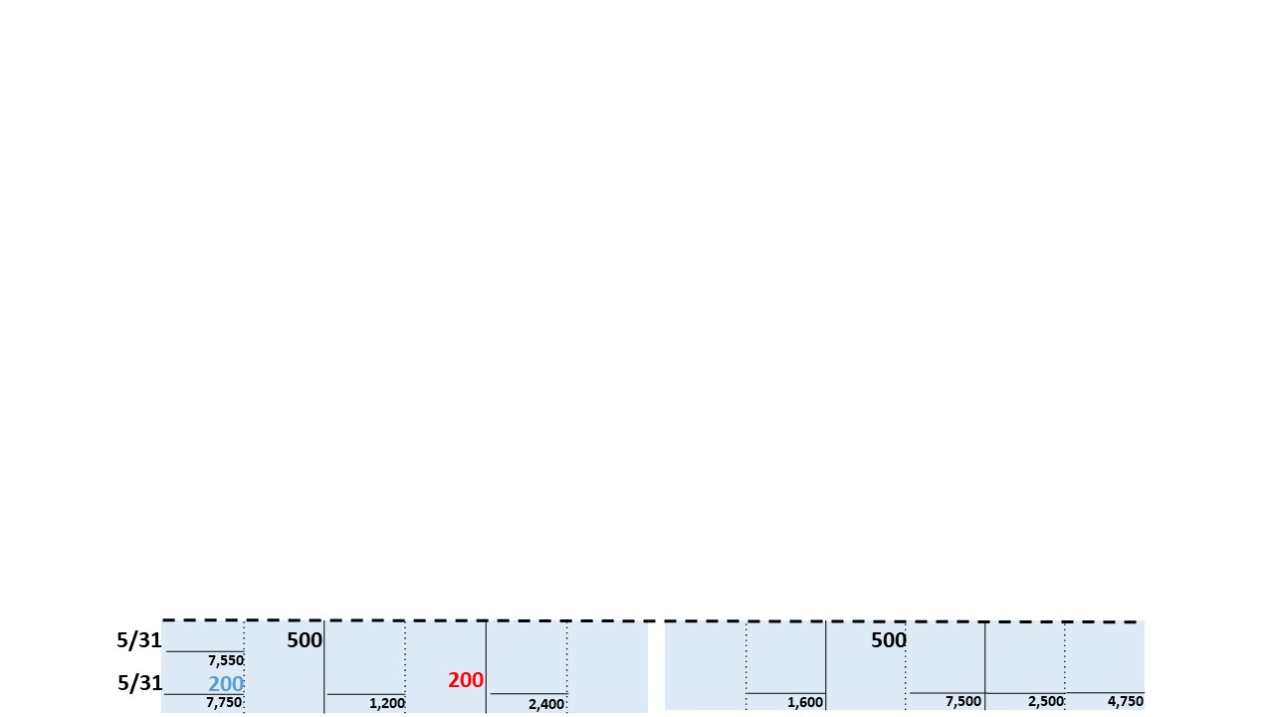
=
A
L + OE
11,350
1,600
9,750
Accounts
Receivable
Accounts
Payable
Operational
Change
Revenue
+
Cash
Supplies
Capital
Decrease
-
Increase
+
Expense
-
Revenue
+
Increase
+
Decrease
-
Increase
+
Decrease
-
Increase
+
Decrease
-
Decrease
-
Increase
+
Decrease
-
5/5
8,000
8,000
5/9
1,200
1,200
Balance
6,800
5/11
The final balances from the transaction recording process is the source of the amounts used on financial statements.
1,500
1,500
5/14
2,750
2,700
2,750
9,550
The final balances of each asset, liability and owner’s equity (below) from the transaction recording process are used in the balance sheet.
5/17
300
300
5/20
600
1,400
2,000
10,150
5/23
2,100
900
1,200
8,050
600
5/26
1,000
1,000
5/31
500
500
7,550
5/31
200
200
7,750
1,200
2,400
1,600
7,500
2,500
4,750

Slide 7
Identify and Prepare a Balance Sheet
ABC Computer Services Balance Sheet May 31, 2020
Assets |  |  | Liabilities
Cash.......................................... | $ 7,750 |  | Accounts payable.............. | $ 1,600
Accounts receivable.................. | 1,200
Supplies..................................... | 2,400
 |  |  | Owner’s Equity
 |  |  | R. Flores, Capital.... | 9,750
 |  |  | Total liabilities and
Total assets............................... | $11,350 |  | owner’s equity.............. | $11,350
Example:
Key Points:
1. Just like the accounting equation, the balance sheet shows wealth (assets) and claims (liabilities and owner's equity) on the wealth. Each side balances at $11,350.
2. The balance sheet is a point in time, not a period of time. It shows position, like a flash photograph. In this case, after the close of business on May 31.
3. Notice that the owner's equity of $9,750 is exactly the same balance as shows on the statement of owner's equity.
4. Amounts on the balance sheet come from the final balances after recording all transactions, and from the final balance on the statement of owner's equity.

Slide 8
How to properly format a balance sheet
ABC Computer Services Balance Sheet May 31, 2020
Assets |  |  | Liabilities
Cash.......................................... | $ 7,750 |  | Accounts payable.............. | $ 1,600
Accounts receivable.................. | 1,200
Supplies..................................... | 2,400
 |  |  | Owner’s Equity
 |  |  | R. Flores, Capital.... | 9,750
 |  |  | Total liabilities and
Total assets............................... | $11,350 |  | owner’s equity.............. | $11,350
The same formatting rules apply to the balance sheet as to the prior statements. In this basic example, there is no need to create indented columns.
Balance sheet format rules:
• Title format rule: first line: name of business, second line: name of financial statement, third line: Date. NOTE: The date is a point in time, not a period of time.
• Items sequence rule: Assets are listed in the order of “liquidity”. “Liquidity” means cash, so cash is shown first. Under cash, the assets are listed in order of ability to provide cash or be used and not require cash. Liabilities are listed in the order of most likely to require cash.
As you practice with more balance sheets, you will become familiar with listing more assets and liabilities.

Slide 9
Alternative balance sheet format
ABC Computer Services Balance Sheet May 31, 2020
 | Assets
 | Cash.................................................................... |  | $7,750
 | Accounts receivable............................................ |  | 1,200
 | Supplies.............................................................. |  | 2,400
 | Total assets..................................................... |  | $11,350
Liabilities
 | Accounts payable............................................... |  | $1,600
 | Owner’s Equity
 | R. Flores, Capital............................................... |  | 9,750
 | Total liabilities and owner’s equity............... |  | $11,350
Alternative format:
An alternative balance sheet format is sometimes used in which assets are placed on top and liabilities and owner's equity are placed underneath. This is called the report form balance sheet. The left/right presentation on the previous slide is called the account form. Both formats are acceptable.

Slide 10
=
A
L + OE
11,350
1,600
9,750
Accounts
Receivable
Accounts
Payable
Operational
Change
Cash
Supplies
Capital
Decrease
-
Increase
+
Expense
-
Increase
+
Decrease
-
Increase
+
Decrease
-
Increase
+
Decrease
-
Decrease
-
Increase
+
Decrease
-
Revenue
+
5/5
8,000
8,000
5/9
1,200
1,200
The capital, revenue, and expense amounts are sources for numbers in the income statement and statement of owner’s equity.
Balance
6,800
5/11
1,500
1,500
5/14
2,750
2,700
2,750
9,550
5/17
300
300
5/20
600
1,400
2,000
10,150
5/23
2,100
900
1,200
8,050
600
5/26
1,000
1,000
5/31
500
500
7,550
7,500
2,500
4,750
5/31
200
200
7,750
1,200
2,400
1,600

Slide 11
Identify and Prepare an Income Statement
ABC Computer Services Income statement For the Month Ended May 31, 2020
 | Service revenue........................... |  |  |  | $ 4,750
 | Expenses
 | Supplies expense..................... |  |  | $ 300
 | Rent expense........................... |  |  | 1,200
 | Advertising expense............... |  |  | 1,000
Total expenses...................... |  |  |  |  | 2,500
 | Net income..................... |  |  |  | $ 2,250
Example:
Key Points:
1. The income statement consists of revenues and expenses.
2. The net income increases business wealth as a result of business operations, and causes an increase in owner’s equity. (A net loss occurs when expenses are greater than revenues. This causes a decrease in business wealth and decrease in owner's equity.)
Note: A somewhat more complex statement may also have “gains” and “losses”. Gains are like revenues and losses are like expenses. However, there is a technical difference between revenues and gains and between expenses and losses. These are discussed later in other learning goals and in Volume 2.

Slide 12
How to properly format an income statement
ABC Computer Services Income statement For the Month Ended May 31, 2020
 | Service revenue........................... |  |  |  | $ 4,750
 | Expenses
 | Supplies expense..................... |  |  | $ 300
 | Rent expense........................... |  |  | 1,200
 | Advertising expense............... |  |  | 1,000
Total expenses...................... |  |  |  |  | 2,500
 | Net income..................... |  |  |  | $ 2,250
1. Title: The title is very important because it identifies three important items: the business, the type of financial statement, and the time period. Title format rule: first line: name of business, second line: name of financial statement, third line: time period.
2. Items sequence: Expenses are subtracted from revenues, therefore: Items sequence rule:
• Place revenues above expenses
• Expenses may be listed in any order, although simple statements sometimes show expenses from largest to smallest.

Slide 13
How to properly format an income statement, continued
ABC Computer Services Income statement For the Month Ended May 31, 2020
 | Service revenue........................... |  |  |  |  | $ 4,750
 | Expenses
 | Supplies expense..................... |  |  |  | $ 300
 | Rent expense........................... |  |  |  | 1,200
 | Advertising expense............... |  |  |  | 1,000
Total expenses...................... |  |  |  |  |  | 2,500
 |  | Net income..................... |  |  |  | $ 2,250
3. Indentation: When there is more than one amount in a category that creates a subtotal that will be combined under another number, the amounts are easier to see when they are indented. Indentation rule: When there are several amounts of the same type of item and the amounts create a subtotal to combine under another number, indent the amounts in a separate column.
4. Dollar signs: Dollar sign rule: Dollar signs are placed to left of the number at the top of column and to the left of the final number in the statement.
5. Lines: Line rule: A double line is always drawn under a final number. Single lines are usually placed under the last amount in an indented column and above totals and subtotals.

Slide 14
Identify and Prepare a Statement of Owner's Equity
ABC Computer Services Statement of Owner's Equity For the Month Ended May 31, 2020
 | R. Flores Capital, May 1................................................ |  |  | $ -0-
 | Add: Owner investments............................................... |  |  | 8,000
 | Net income........................................................... |  |  | 2,250
 |  |  |  | 10,250
 | Less: withdrawals......................................................... |  |  | 500
 | R. Flores Capital, May 31............................................. |  |  | $ 9,750
Example:
Key Points:
The statement of owner's equity includes all changes in owner's equity.
2. The statement combines net income as shown on the income statement with owner investments and withdrawals.
3. This is a new business, so the beginning balance is zero. For a continuing business, the ending balance of the prior period would carry over to become the beginning balance of the next period.

Slide 15
How to properly format a statement of owner's equity
ABC Computer Services Statement of Owner's Equity For the Month Ended May 31, 2020
 | R. Flores Capital, May 1................................................ |  |  | $ -0-
 | Add: Owner investments............................................... |  |  | 8,000
 | Net income........................................................... |  |  | 2,250
 |  |  |  | 10,250
 | Less: withdrawals......................................................... |  |  | 500
 | R. Flores Capital, May 31............................................. |  |  | $ 9,750
The same formatting rules generally apply to the statement of owner's equity as discussed for the income statement. An exception is that multiple items are not usually indented in a separate column because the statement is relatively simple.
Format rules review:
• Title format rule: first line: name of business, second line: name of financial statement, third line: time period.
• Dollar sign rule: Dollar signs are placed to left of the number at the top of column and to the left of the final number in the statement.
• Line rule: A double line is always drawn under a final number. Single lines are usually placed under the last amount in an indented column and above totals and subtotals.

Slide 16
Identify a Statement of Cash Flows
ABC Computer Services Statement of Cash Flows For the Month Ended May 31, 2020
Cash flows from operating activities
Receipts:
Cash collections from customers................................... | $3,550
Payments:
Payments for operating expenses.................................... | (3,300)
Increase in cash from operating activities................... | 250
Cash flows from investing activities
Change in cash from investing activities..................... | -0-
Cash flows from financing activities
Owner investment............................................................. | 8,000
Owner withdrawals........................................................... | (500)
Increase in cash from financing activities..................... | 7,500
Net increase in cash......................................... | 7,750
Beginning cash balance, May 1 ................................................ | -0-
Ending cash balance, May 31.................................................... | $ 7,750

Slide 17
Identify a Statement of Cash Flows, continued
ABC Computer Services Statement of Cash Flows For the Month Ended May 31, 2020
Cash flows from operating activities
Receipts:
Cash collections from customers................................... | $3,550
Payments:
Payments for operating expenses.................................... | (3,300)
Increase in cash from operating activities................... | 250
Cash flows from investing activities
Change in cash from investing activities..................... | -0-
Key Points:
A statement of cash flows explains the change from the beginning cash balance to the ending cash balance. The final balance is the same as the cash balance on the balance sheet.
The three key elements to look for in a statement of cash flows are:
• Operating activities: This explains the change in cash as a result of the revenues and expenses from income statement. This is a very useful number to a business owner: Notice that even though the business
had net income of $2,250 there was only a $250 increase in cash resulting from the operations.
• Investing activities: This shows the cash changes from buying and selling plant and equipment and making and collection loans.

Slide 18
Identify a Statement of Cash Flows, continued
Cash flows from financing activities
Owner investment............................................................. | 8,000
Owner withdrawals........................................................... | (500)
Increase in cash from financing activities..................... | 7,500
Net increase in cash......................................... | 7,750
Beginning cash balance, May 1 ................................................ | -0-
Ending cash balance, May 31.................................................... | $ 7,750
• Financing activities: This shows the cash changes resulting from owner investing, borrowing, withdrawals, and paying loans.

Slide 19
Identify a Statement of Cash Flows, continued
ABC Computer Services
Statement of Cash Flows
For the Month Ended May 31, 2020
Cash flows from operating activities
Receipts:
Cash collections from customers................................... | $3,550
Payments:
Payments for operating expenses.................................... | (3,300)
Increase in cash from operating activities................... | 250
Cash flows from investing activities
Change in cash from investing activities..................... | -0-
Cash flows from financing activities
Owner investment............................................................. | 8,000
Owner withdrawals........................................................... | (500)
Increase in cash from financing activities..................... | 7,500
Net increase in cash......................................... | 7,750
Beginning cash balance, May 1 ................................................ | -0-
Ending cash balance, May 31.................................................... | $ 7,750
3. Actually preparing a statement of cash flows is a more advanced topic that is not required at this point.

Slide 20
ABC Computer Services Income statement For the Month Ended May 31, 2020
 | Service revenue........................... |  |  |  | $ 4,750
 | Expenses
 | Supplies expense..................... |  |  | $ 300
 | Rent expense........................... |  |  | 1,200
 | Advertising expense............... |  |  | 1,000
Total expenses...................... |  |  |  |  | 2,500
 | Net income..................... |  |  |  | $ 2,250
ABC Computer Services Statement of Owner's Equity For the Month Ended May 31, 2020
 | R. Flores Capital, May 1................................................ |  |  | $ -0-
 | Add: Owner investments............................................... |  |  | 8,000
 | Net income........................................................... |  |  | 2,250
 |  |  |  | 10,250
 | Less: withdrawals......................................................... |  |  | 500
 | R. Flores Capital, May 31............................................. |  |  | $ 9,750
See next slide

Slide 21
ABC Computer Services Balance Sheet May 31, 2020
Assets |  |  | Liabilities
Cash.......................................... | $ 7,750 |  | Accounts payable.............. | $ 1,600
Accounts receivable.................. | 1,200
Supplies..................................... | 2,400
 |  |  | Owner’s Equity
 |  |  | R. Flores, Capital.... | 9,750
 |  |  | Total liabilities and
Total assets............................... | $11,350 |  | owner’s equity.............. | $11,350
ABC Computer Services Statement of Cash Flows For the Month Ended May 31, 2020
Cash flows from operating activities
Receipts:
Cash collections from customers................................... | $3,550
Payments:
Payments for operating expenses.................................... | (3,300)
Increase in cash from operating activities................... | 250
Cash flows from investing activities
Change in cash from investing activities..................... | -0-
Cash flows from financing activities
Owner investment............................................................. | 8,000
Owner withdrawals........................................................... | (500)
Increase in cash from financing activities..................... | 7,500
Net increase in cash......................................... | 7,750
Beginning cash balance, May 1 ................................................ | -0-
Ending cash balance, May 31.................................................... | $ 7,750

Slide 22
Special purpose financial statements
In addition to the four required general-purpose financial statements, businesses also prepare special-purpose financial statements, usually for internal use by management. This is often called managerial accounting. Examples of special-purpose internal statements are:
1. Product cost analysis: The purpose of these statements is analysis costs in detail, and assign
these costs to individual product units in a careful and logical way.
2. Product profitability analysis: When a company produces multiple services or products,
profitability analysis statements disclose the profitability by service or product type.
3. Cost-volume-profit analysis: These statements indicate changes in profitability according to
changes in cost structure and volume of production and sales. These are often used as planning
devices when considering a new business or new product.
4. Budget statements: Budget statements are planning devices that set goals for a designated
objective, such as profitability or cash flow. The budget goals are then compared to actual
results, and any differences are analyzed. The analysis provides feedback information that is
used for operational and strategic changes.

