Slide 1
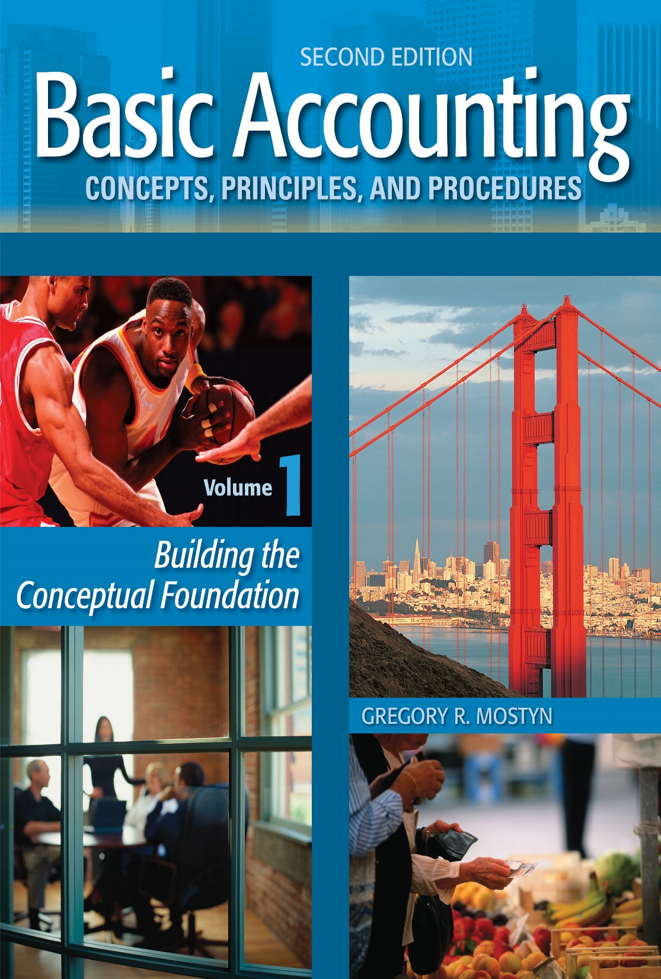
Basic Accounting Concepts Principles and Procedures, 2nd Edition, Volume 1
Basic Accounting Concepts Principles and Procedures, 2nd Edition, Volume 1

Slide 2
Enhanced Introduction Learning Goals 2-4

Slide 3
Assets
• In accounting, the word “asset” has a very specific meaning.
• An asset is property that 1) will provide future benefits and 2) is owned as the result of a past transaction.
• Because property usually has economic value, an asset is also usually wealth.

Slide 4
Assets, continued
• Future benefits are also called “service potential”
• As assets are used and/or time passes, future benefits usually expire.
Examples:
Asset | Future Benefits
Truck | Shipping, transportation, advertising
Computer | Calculations, analysis, communication, research, financial statements, other reports
Table | Various types of work, storage
Cash | Can be used to obtain other assets and services and pay debts.

Slide 5
Assets, continued
• “Owned as the result of a past event” means that a business must own property in
order for that property to be considered a business asset.
• “Ownership” means complete control over all (legal) uses of property. This
includes using, selling, exchanging, and disposing of the property.
• “Past event” means that ownership does not depend on plans, promises, or
contingencies upon future events. A past event also provides the following:
• Objective evidence: Objective evidence is documentation or other proof of an
asset being acquired.
• Historical cost: Historical cost is part of objective evidence. Historical cost is
the dollar value to use when recording an asset acquisition. Historical cost is
a reliable value.

Slide 6
Assets, continued
Item | An Asset? | Because...
Land and building bought 10 years ago
Office furniture bought last year
Accounts receivable from sales last month
Employee
Supplies in the budget to buy
Cash
Stock investments purchased last year
Truck rented from a rental company
Broken equipment that cannot be sold
Yes
the land and building are owned by the business and provide future benefits.
Yes
the office furniture is owned by the business and provides future benefits.
Yes
the accounts receivable are owned by the business and provides future benefits (future cash receipts).
No
employees are not property and cannot be owned.
No
they are not owned by the business – a budget is only a plan.
Yes
the cash is owned by the business and provides future benefits.
the investments are owned by the business and provide future benefits
(cash value, although it changes).
Yes
No
the truck is not owned by the business.
No
there are no future benefits.

Slide 7
Claims on Assets
• There are two kinds of legal claims on business assets.
1) The owner’s equity
2) The creditors’ equity
• In accounting and finance the word “equity” usually means a dollar-value claim.

Slide 8
Owner’s Equity
• Definition: Owner’s equity is an owner’s legal claim on the assets of his/her
business. Other terms for owner’s equity are net worth and net assets.
Example: The assets of Joan’s Garden Company are $125,000. This consists of cash, accounts receivable, merchandise, supplies, and equipment. If there are no debts, the entire $125,000 value can be claimed by the owner because the business belongs to the owner.

Slide 9
Creditors’ Equity
• Definition: Creditors’ equity is the creditors’ claim on the dollar value business
assets. These claims are usually called liabilities.
Example: The assets of Joan’s Garden Company are $125,000. The business has received trade credit of $15,000 from suppliers and also has a bank loan of $50,000. The total liabilities are $65,000.
• When a business fully pays a liability (a debt), that liability disappears.
• Why a liability exists: A liability is created as the result of obtaining goods or
services on credit or borrowing money.
When... | and... | then...
resources are provided by someone other than the owner | the resources are not immediately paid for | a liability (a debt) is created.

Slide 10
Priority of Claims
• Creditors’ have the first priority claim on the value of business assets, before the owner.
• Creditors’ claims must be paid when they become due or the creditors can take legal action to obtain payment.
• This also means that if a business is sold or liquidated an owner will receive only what is left over after the creditors are paid. Therefore the owner’s equity is a residual claim. If assets are sold for more or less than what was recorded, this will affect only the owner’s claim.
Example:
Bill’s Company has $200,000 of assets and $90,000 of liabilities, so the owner’s equity is $110,000. The business ceases operations and is liquidated. If the assets sell for $200,000, Bill will receive $110,000. If the assets sell for more or less than $200,000, Bill will receive more or less. However, the creditors are always entitled to the fixed amount of $90,000.

Slide 11
The Accounting Equation
• The relationship between wealth and claims on the wealth can be described by a
simple equation, called the “accounting equation”.
• The accounting equation is: Assets = Liabilities + Owner's Equity
OR simply:
A = L + OE
• What it means: There are only two possible claims on wealth:
liabilities (debts) and owner’s equity.
• The accounting equation is the basic economic description of any entity.

Slide 12
The Accounting Equation, continued
Examples
Assets | Liabilities | Owner’ Equity | Answer
$120,000 | $65,000 | ?
? | $81,000 | $47,000
$240,000 | ? | $130,000
$120,000 | $165,000 | ?
$55,000
$128,000
$110,000
($45,000)*
* It is possible for owner's equity to be negative. How do you think this happens
and how do you think it affects the owner?

