Slide 1
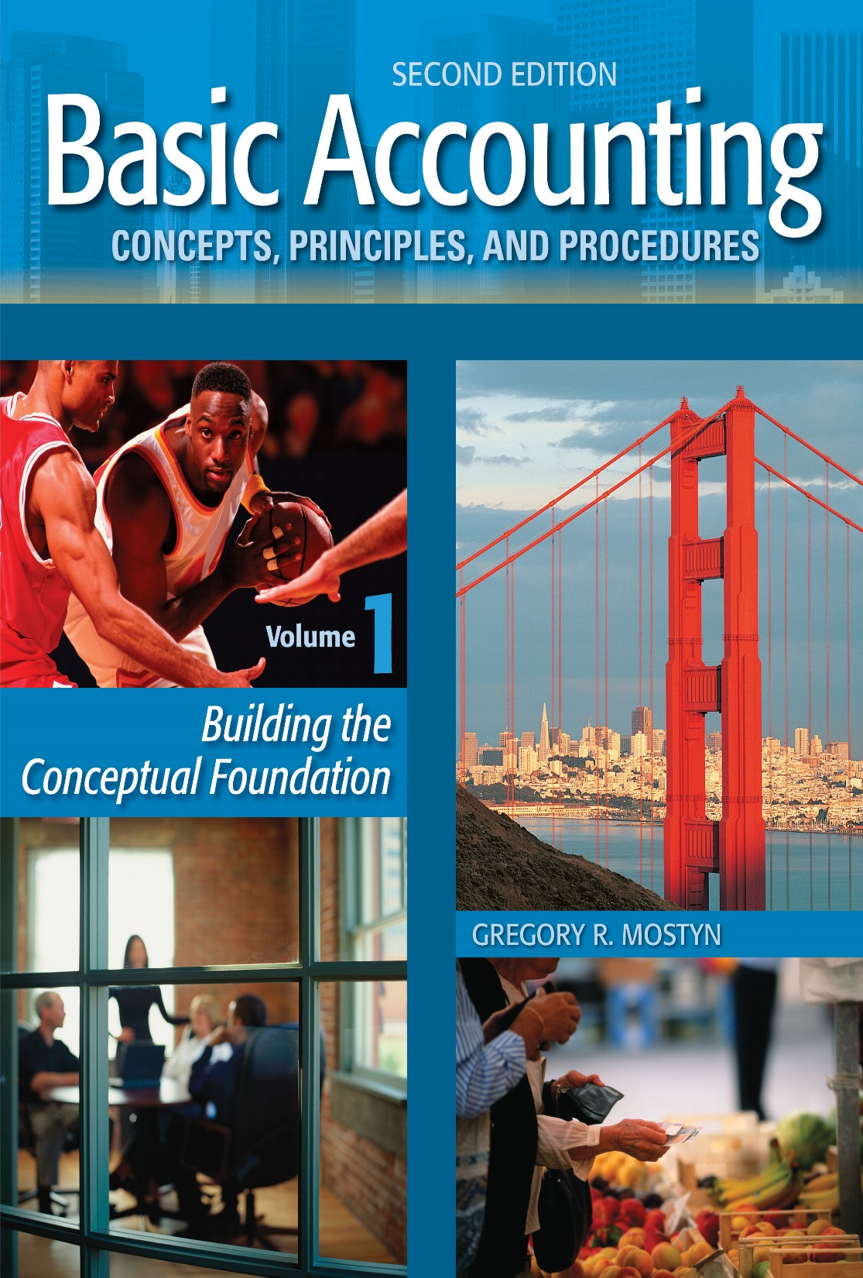
Basic Accounting Concepts Principles and Procedures, 2nd Edition, Volume 1
Basic Accounting Concepts Principles and Procedures, 2nd Edition, Volume 1

Slide 2
Learning Goal 30

Slide 3
Treasury Stock
• Treasury stock is a company’s own stock that it has sold and then reacquired. The
company acquires the stock simply by buying it back at the current market price.
• A company may buy its own stock for the following reasons:
1) To reissue the stock later at a higher price, and thereby obtain a greater
amount of investment
2) Stabilize or increase the market price of the stock by creating demand and
reducing the number of shares available for trading
3) Prevent a large investor from acquiring a large number of shares and
exercising voting influence
4) Obtain additional available shares to reissue to company employees or for
other purposes

Slide 4
Treasury Stock, continued
• Treasury stock transactions are most often recorded using the “cost method”.
This means that treasury stock purchases are recorded at cost.
• When a company buys its own stock, an account called “Treasury Stock” is
debited for the cost of the stock.
• The Treasury Stock account is not an asset, but rather is a contra-equity account.
• The next examples will illustrate this

Slide 5
Treasury Stock Purchase Example
Illustrated below is the balance sheet stockholders' equity section of a company before a treasury stock purchase. On April 3, the company purchases 5,000 shares of treasury stock at a cost of $7 per share.
 | Stockholders' Equity
 | Paid-in capital
 | Preferred stock, $50 par, 5%, 8,000 shares issued........................................................... |  |  | $400,000
 | Paid-in capital in excess of par, preferred....... |  |  | 20,000 | $ 420,000
 | Common stock $.01 par value, 100,000 shares issued................................................ |  |  | 1,000
 | Paid-in capital in excess of par, common........ |  |  | 855,000 | 856,000
 | Total paid-in capital.................................... |  |  |  | 1,276,000
 | Retained earnings........................................... |  |  |  | 1,812,500
 | Total stockholders' equity....................... |  |  |  | $3,088,500
The treasury stock purchase is recorded as illustrated below:
4/3 | Treasury Stock | 35,000
 | Cash |  | 35,000

Slide 6
Treasury Stock Example, continued
The new stockholders’ equity section of the balance sheet would be:
 | Stockholders' Equity
 | Paid-in capital
 | Preferred stock, $50 par, 5%, 8,000 shares issued........................................................... |  |  | $400,000
 | Paid-in capital in excess of par, preferred...... |  |  | 20,000 | $ 420,000
 | Common stock $.01 par value, 100,000 shares issued, 95,000 shares outstanding... |  |  | 1,000
 | Paid-in capital in excess of par, common....... |  |  | 855,000 | 856,000
 | Total paid-in capital.................................... |  |  |  | 1,276,000
 | Retained earnings........................................... |  |  |  | 1,812,500
 | Total paid-in capital and retained earnings.... |  |  |  | 3,088,500
 | Less: treasury stock at cost............................ |  |  |  | (35,000)
 | Total stockholders' equity...................... |  |  |  | $3,053,500
• The common stock description now includes both shares issued and “shares outstanding”. Shares outstanding means issued shares that are not treasury stock.
• The common stock paid-in capital account balances ($1,000 and $855,000) are not adjusted. It is easier to simply reduce the total stockholders' equity by the cost of treasury shares of $35,000. This is the debit balance in the treasury stock account.

Slide 7
Treasury Stock Reissue Above Cost
• Assume that on June 8 the company now sells 1,000 shares of the treasury stock at
$9 per share. The entry to record the sale is illustrated below:
6/8 | Cash | 9,000
 | Treasury Stock |  | 7,000
 | Paid-in Capital From Treasury Stock |  | 2,000
Cash: 1,000 X $9 = $9,000
Paid-in Capital From Treasury Stock: $9,000 – $7,000 cost = $2,000
• Notice that there is no gain or loss recorded – the income statement is not affected.
The sale above cost simply results in $9,000 more stockholders' equity as the result
of more investment.

Slide 8
Treasury Stock Reissue Above Cost, continued
The new stockholders’ equity section would be:
 | Stockholders' Equity
 | Paid-in capital
 | Preferred stock, $50 par, 5%, 8,000 shares issued........................................................... |  |  | $400,000
 | Paid-in capital in excess of par, preferred...... |  |  | 20,000 | $ 420,000
 | Common stock $.01 par value, 100,000 shares issued, 96,000 shares outstanding.. |  |  | 1,000
 | Paid-in capital in excess of par, common....... |  |  | 855,000
 | Paid-in capital from treasury stock............... |  |  | 2,000 | 858,000
 | Total paid-in capital.................................... |  |  |  | 1,278,000
 | Retained earnings........................................... |  |  |  | 1,812,500
 | Total paid-in capital and retained earnings.... |  |  |  | 3,090,500
 | Less: treasury stock at cost............................. |  |  |  | (28,000)
 | Total stockholders' equity....................... |  |  |  | $3,062,500
• Total stockholder’s equity has increased by $9,000: The $7,000 decrease in treasury stock
account (to the new balance of $28,000) plus the additional $2,000 of new paid-in capital.

Slide 9
Treasury Stock Reissue Below Cost
• Now assume that on July 12 the company sold 600 more shares of the treasury
stock at $5 per share. The entry to record the sale is illustrated below:
7/12 | Cash | 3,000
 | Paid-in Capital From Treasury Stock | 1,200
 | Treasury Stock |  | 4,200
Cash: 600 X $5 = $3,000
Reduction in Paid-in Capital From Treasury Stock: $3,000 – $4,200 cost = -$1,200
• Notice that there is no gain or loss recorded – the income statement is not affected.
The sale below cost still results in a $3,000 increase in stockholders' equity as the
result of receiving that much investment, even though it is less than the full cost of
the shares.
• If there is no paid-in capital from treasury stock, retained earnings can be
reduced.

Slide 10
Treasury Stock Reissue Below Cost, continued
The new stockholders’ equity section is shown below:
 | Stockholders' Equity
 | Paid-in capital
 | Preferred stock, $50 par, 5%, 8,000 shares issued........................................................... |  |  | $400,000
 | Paid-in capital in excess of par, preferred...... |  |  | 20,000 | $ 420,000
 | Common stock $.01 par value, 100,000 shares issued, 96,600 shares outstanding.. |  |  | 1,000
 | Paid-in capital in excess of par, common....... |  |  | 855,000
 | Paid-in capital from treasury stock............... |  |  | 800 | 856,800
 | Total paid-in capital.................................... |  |  |  | 1,276,800
 | Retained earnings........................................... |  |  |  | 1,812,500
 | Total paid-in capital and retained earning..... |  |  |  | 3,089,300
 | Less: treasury stock at cost........................... |  |  |  | (23,800)
 | Total stockholders' equity...................... |  |  |  | $3,065,500

Slide 11
Retirement of Stock
• Stock can also be “retired”. This means that a company purchases its stock and
cancels the shares so that they can never be reissued.
• Par value and paid in capital in excess of par accounts are permanently reduced in the same proportion as the number of shares reacquired to total shares issued. For any difference between the cash paid and the reduction in paid in capital, retained earnings will be reduced.
• Retirement results in a permanent reduction of stockholders' equity.

Slide 12
Stock Dividends
• A stock dividend is a proportional distribution of company shares of stock among its
existing stockholders, with no change in par value of stated value.
• Example: A company has 200,000 shares of stock outstanding. The company
declares a 6% stock dividend. If an investor owns 100 shares, that investor will
receive 6 new shares. 12,000 total shares will be distributed.
• Stock dividends might be declared for the following reasons:
• Stock dividends conserve cash, yet still offer something stockholders like to
receive.
• Large stock dividends reduce the market price of stock. Companies may wish to
do this if they want to make their stock more affordable to small investors.
• Stock dividends increase paid-in capital and reduce retained earnings, which
makes less retained earnings available for cash dividends.

Slide 13
The Value to Use for Stock Dividends
• A stock dividend is a proportional distribution of company shares of stock among its
existing stockholders, with no change in par value of stated value.
IF... | THEN...
Small Stock Dividend The dividend is less than about 20-25% of the outstanding shares before the dividends are declared ... | Use the market value per share at the time of the dividend
Large Stock Dividend The dividend is greater 25% of the outstanding shares before the dividends are declared... | Use the par or stated value of the stock. (For no-par stock, check state law.)

Slide 14
Small Stock Dividend Example
The stockholders' equity of Watson Company is shown below.
 | Stockholders' Equity
 | Paid-in capital
 | Common stock $.01 par value, 300,000 shares issued and outstanding.................. |  |  | $ 3,000
 | Paid-in capital in excess of par, common..... |  |  | 5,430,000
 | Total paid-in capital.................................. |  |  |  | $ 5,433,000
 | Retained earnings......................................... |  |  |  | 510,000
 | Total stockholders' equity..................... |  |  |  | $ 5,943,000
On October 29, the board of directors declares a 3% stock dividend at the time the market price of the stock is $19 per share.
10/29 | Retained Earnings | 171,000
 | Common Stock Distributable |  | 90
 | Paid-in Capital in Excess of Par |  | 170,910
Retained earnings: 300,000 X .03 X $19 = $171,000
On November 15, the stock is distributed
11/15 | Common Stock Distributable | 90
 | Common Stock |  | 90

Slide 15
Large Stock Dividend Example
Instead of 3%, assume that Watson company declares and distributes a 30% stock dividend.
On October 29, the board of directors declares a 30% stock dividend at the time the market price of the stock is $19 per share.
10/29 | Retained Earnings | 900
 | Common Stock Distributable |  | 900
On November 15, the stock is distributed
11/15 | Common Stock Distributable | 900
 | Common Stock |  | 900

Slide 16
Stock Dividend Summary
• “Common stock distributable” is part of paid-in capital. The dividend has been
declared, so paid-in capital is increased to show that the distribution will be
coming.
• When the stock is distributed Common Stock Distributable changes to Common
Stock.
• All dividends come out of retained earnings, so retained earnings is debited to
reduce retained earnings.
• There is no change in the value of the business. There is simply an amount
transferred between stockholders' equity accounts from retained earnings into
paid-in capital accounts. Retained earnings is permanently reduced.
• The number of outstanding shares increases.

Slide 17
Stock Splits
• A stock split is a simultaneous increase in the number of shares issued and a
decrease in the par or stated value per share.
• Effects of a stock split:
• Total shares issued increases. This includes shares outstanding and treasury
stock. There is no change in authorized shares.
• Par or stated value per share is reduced but there is no change in total par or
stated value.
• Stockholders receive new shares that replace old shares.
• Reasons for a stock split:
• Splits do not require cash but are perceived by stockholders as something
valuable (Even though the value of the company is unchanged).
• Splits usually involve more shares than stock dividends, but splits do not reduce
retained earnings.
• More shares outstanding reduces the price of the stock from what it otherwise
would have been. This makes the stock more accessible to smaller investors.

Slide 18
Recording Stock Splits
• A stock split does not have any effect on the amounts of any account balances.
Therefore only a notation is required to record a split. The notation
should identify the date, the number of new shares for old shares, and change in
par or stated value per share. Account balances are unchanged.
Example of different stock splits:
 | Par Value | X | Shares Issued | = | Total $ Par Value
Before split | $.10 |  | 20,000 |  | $2,000
2 for 1 | .05 |  | 40,000 |  | 2,000
3 for 2 | .06667 |  | 30,000 |  | 2,000
5 for 4 | .08 |  | 25,000 |  | 2,000
Stockholder example: If a stockholder owns 200 shares, after a 3:2 stock split the stockholder will own 200 X 3/2 = 300 new shares. The par value per share will be 2/3 of the old par value.

Slide 19
More On Retained Earnings
• Retained earnings is not a claim on any particular asset and has no relationship to
the amount of cash (or any other asset). Retained earnings is the total
stockholders' claim on assets, after creditors.
• Retained earnings has a normal credit balance, but can have a debit balance if
losses exceed profits.
• There must be credit balance in retained earnings for there to be dividends.
However, retained earnings can be restricted or appropriated.
Restriction: makes an amount of retained earnings unavailable for dividends. This
must be disclosed in footnotes.
Appropriation: makes an amount of retained earnings unavailable for dividends,
and records the amount as a formal journal entry. Also disclosed in notes.
xx/xx | Retained Earnings | $$
 | Retained Earnings - Appropriated |  | $$

Slide 20
Prior Period Adjustments
• Prior period adjustments occur when a business discovers material revenue or
expense errors that occurred in a prior accounting period. An adjustment is made
in the current period for the error occurring in the prior period.
• The correction is made to retained earnings and whatever other balance sheet
account that was affected by the error.
• The retained earnings account is adjusted because revenues and expenses
determine net income, and net income flows into retained earnings when the books
are closed.
Example:
The Smith Corporation discovered that last year it forgot to record $20,000 of prepaid travel that had actually been used up and should have been recorded as an expense. Therefore net income was overstated last year, making retained earnings overstated. The journal entry this year to reduce retained earnings is:
xx/xx | Retained Earnings | 20,000
 | Prepaid Travel |  | 20,000

Slide 21
Change in Accounting Principle
• A change in accounting principle occurs when a company changes from one generally accepted accounting principle to a different generally accepted accounting principle.
• A change in accounting principle can only be made if 1) management can demonstrate that the new principle used will result in better financial reporting than the prior principle, or 2) the change is required as the result of a pronouncement from the Financial Accounting Standards Board.

Slide 22
How to Make a Change in Accounting Principle
1) Calculate the cumulative effect of the change for all prior accounting periods.
2) Record a journal entry that adjusts the balance of any assets and liabilities affected to their balances under the newly adopted principle, and that records any cumulative effect on retained earnings.
3) Adjust the financial statements of all affected prior periods and the current period by applying the new principle.
Example:
In the current year, Jones Company changes to an accounting principle that changes the method of recording sales revenue for certain kinds of items. The effect would have been to increase revenue by $10,000 for each of the prior three years and decrease the balance of unearned revenue.
Jones Company must correct any prior year financial statement that it presents for comparison with the current year. As well, the beginning balance of retained earnings in the current year must be increased by $30,000 and unearned revenue decreased by $30,000. Current year entry:
xx/xx | Unearned Revenue | 30,000
 | Retained Earnings |  | 30,000

Slide 23
The Statement of Retained Earnings
A statement of retained earnings is prepared to show all the current period changes in the retained earnings account. The ending balance must be the same as the amount on the current balance sheet. The example below also includes a prior period adjustment and change in accounting principle.
 | ABC Corporation Statement of Retained Earnings For the Year Ending December 31, 20xx
 | Balance, January 1, as reported........................ |  |  |  | $ 760,000
 | Correction for prior year understated income.. |  |  | $ 22,000
 | Change in accounting principle......................... |  |  | (12,000) | 10,000
 | Balance, January 1, as revised.................. |  |  |  | 770,000
 | Net income........................................................ |  |  |  | 85,000
 | Less: cash dividends.......................................... |  |  |  | (50,000)
 | Balance, December 31....................................... |  |  |  | $ 805,000

