Slide 1
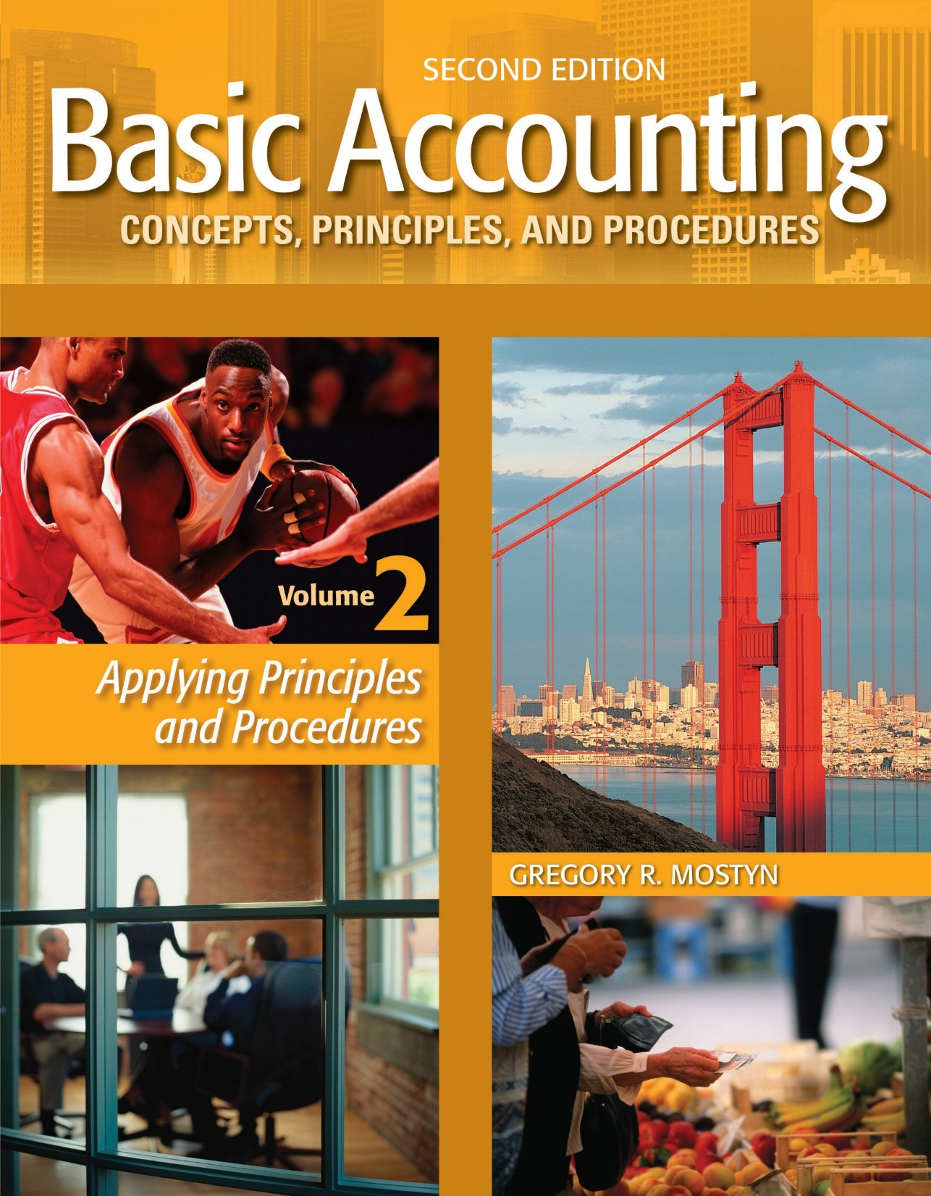
Basic Accounting Concepts Principles and Procedures, 2nd Edition, Volume 1
Basic Accounting Concepts Principles and Procedures, 2nd Edition, Volume 2

Slide 2
Learning Goal 10

Slide 3
Introduction to Merchandising Operations
• A merchandising company is a business that offers merchandise for sale.
A merchandising company purchases merchandise from merchandise
suppliers or manufacturers and then sells to customers.
• A wholesale merchandising business sells to customers who are other
merchants or manufacturers.
• A retail merchandising business sells to customers who are the final users
of products.
• Some merchandising companies sell both services and merchandise.

Slide 4
Introduction to Merchandising Operations, continued
Examples:
Business Type | Merchandising | Services | Because...
Grocery store | X |  | it sells only groceries and other merchandise (most stores).
Watch repair store | X | X | it sells both repair services and watches and parts.
Accounting office |  | X | it sells only accounting and tax services.
Restaurant | X | X | it sells both food and drinks, and provides the service of making them available.
Computer manufacturer | ------- | ------- | it makes the final product, so it is not a merchandising company or a service company.

Slide 5
Merchandising Operating Cycle
• The operating cycle of a business is the process by which a business spends cash for business operations and
then eventually receives more cash back from customers.
Illustration of Merchant Operating Cycle
Spend $ for Merchandise
$ Cash $
Receivable Collections
Merchandise Inventory
Cash
Payments
Accounts
Receivable
Sell to Customers

Slide 6
Sales, Cost of Goods Sold, and Gross Profit
• A merchandising company’s revenue account for merchandise sold to
customer is called “sales” or “sales revenue”.
• A merchandising company uses an expense account that is not used in a
service company. This account is called cost of goods sold, or sometimes
“cost of sales”. Cost of goods sold is often the largest expense for a
merchandising company. It is the cost of the merchandise that is used up
when it is sold to a customer.
• The income statement of merchandise company shows a line item called
“gross profit” or sometimes called “gross margin”. Gross profit is
calculated as: Sales – Cost of Goods Sold = Gross Profit. Gross profit
shows the amount of sales dollars that remain to cover all other expenses
and provide a net income.

Slide 7
Income Statement Diagram:
Sales, Cost of Goods Sold, and Gross Profit Illustrated
Net Sales
Minus
Cost of Goods Sold
Equals
Gross Profit
Minus
Operating Expense
Equals
Income Before Tax

Slide 8
The Cost of Goods Sold Calculation
• The basic formula for calculating cost of goods sold shows the three
elements that comprise cost of goods sold. The formula is:
BI + P – EI = C of GS
BI: The cost of beginning inventory at the start of the accounting period
P : The cost of purchases during the period
EI: The cost of ending inventory at the end of the period
C of GS: Cost of goods sold
• What the formula tells us is that if we add the cost of initial inventory balance plus the cost of purchases, that will be cost of all the inventory available during the period. Then if we subtract the cost of what is left over, the difference must be the cost of what was sold.

Slide 9
The Cost of Goods Sold Calculation, continued
• The basic formula of BI + P – EI = C of GS is also referred to as the
“ periodic inventory method”. It is called this because in order to
determine cost of goods sold, it is necessary to periodically count the
ending inventory and determine its cost. If this is not done, we cannot
know the cost of the ending inventory.
• Example: Bayview Company had $40,000 of beginning merchandise
inventory and purchased $200,000 more during the year. At the end of
the year, the inventory count showed an ending inventory cost of
$15,000.
$40,000 + $200,000 – $15,000 = $ $225,000 cost of goods sold.

Slide 10
The Cost of Goods Sold Calculation, continued
• A second method frequently used for inventory is called the “perpetual inventory method” This method calculates the cost of goods sold continuously with every sale on a daily basis. This requires more detailed record-keeping.
The formula represents this method as:
BI + P – C of GS = EI (daily)
• Here the formula is telling us that if we identify the cost of goods sold with each sale, then we will also know the inventory balance continuously after each sale. This is a more precise method that we will discuss later.
• Example: At the start of the day Portland Company had $12,000 of inventory on hand. During the day it purchased an additional $8,000 of inventory and made sales with an inventory cost of $11,000.
$12,000 + $8,000 – $11,000 = $ 9,000 inventory at end of day
• An ending balance is still verified by physical count at least annually.

Slide 11
Periodic vs. Perpetual Overview
• Both the periodic and perpetual methods are used in practice. Each method
has advantages and disadvantages. The table below summarizes the key
features of each method.
Perpetual | Periodic
Maintains a continuous daily record of both merchandise purchased and sold. | Maintains a continuous daily record of only merchandise purchased.
A new inventory balance is available after each sale or each day’s activity. | A new inventory balance is determined by physical count only at the end of the period.
Cumulative cost of goods sold is known continually. | Cumulative cost of goods sold is known only at the end of the period when inventory is counted.
Maintains close control over inventory | Does not closely control inventory.
Is more precise, but also more expensive to operate. | Is less precise, but also less expensive to operate.
Tends to be used for low volume or expensive goods, unless computer systems extensively utilized. | Tends to be used for high volume, inexpensive goods, although can be used for any kind of inventory.

