Slide 1
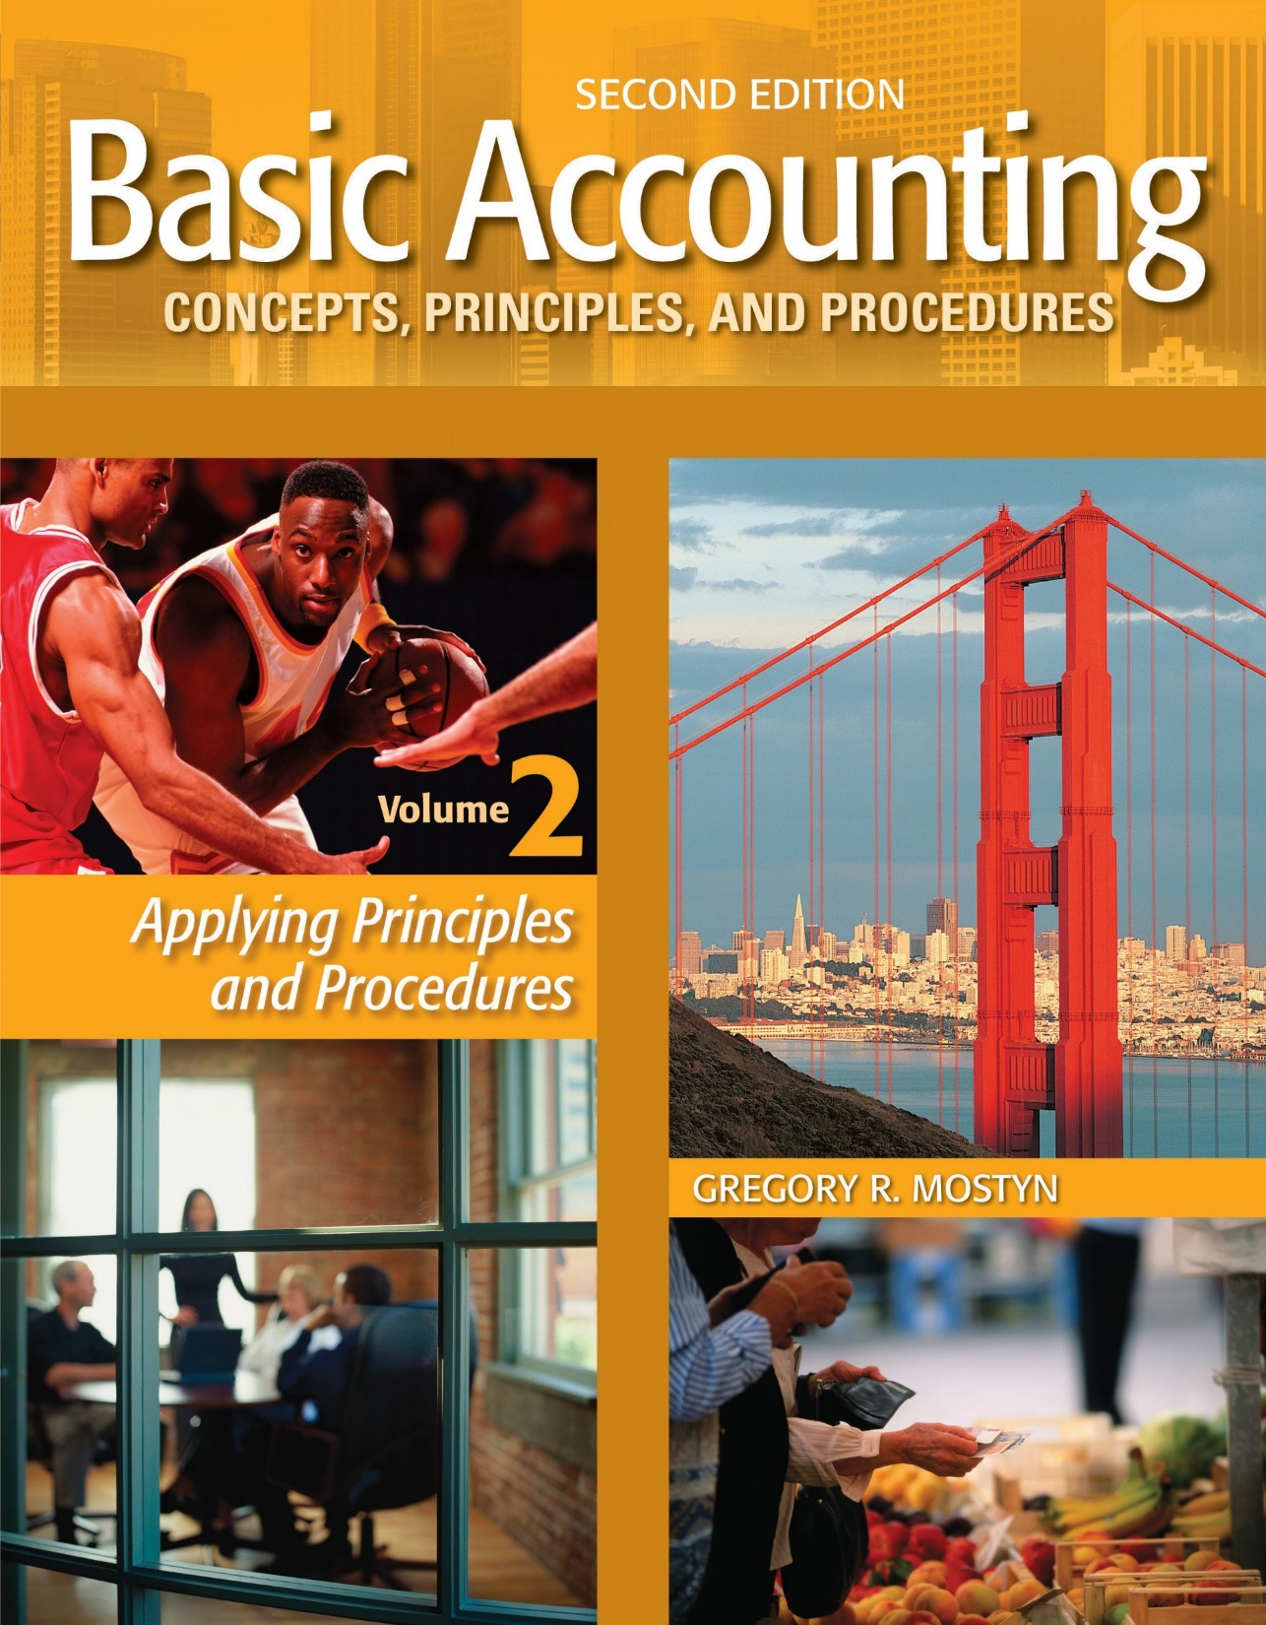
Basic Accounting Concepts Principles and Procedures, 2nd Edition, Volume 1
Basic Accounting Concepts Principles and Procedures, 2nd Edition, Volume 2

Slide 2
Learning Goal 11 Part 1

Slide 3
Periodic Inventory Method
Recording Revenue
• The fundamental principle for revenue recognition is to record revenue
when it is earned, regardless of when cash is received. This is usually at
the point of sale, when:
• The seller delivers what was agreed upon at the agreed price, and
• The buyer can reasonably be expected to pay or has paid

Slide 4
Periodic Inventory Method
Recording Revenue, continued
• For goods that are being shipped, in most circumstances the point of delivery is considered to be the FOB point. The term “FOB” means “free on board” and refers to the point at which ownership is considered to transfer from seller to buyer.
Examples: Merchandise is being shipped by truck from Chicago to Los Angeles.
#1) The shipping terms specify “FOB shipping point”: This means the sale is recognized when the goods are loaded on the truck in Chicago. At this point the buyer owns the merchandise. Buyer must also pay freight from Chicago and assume risk of loss (if no insurance).
#2) The shipping terms specify “FOB delivery point”: The sale would not take place until the goods are unloaded in Los Angeles. Seller would pay freight to Los Angeles and assume risk of loss.

Slide 5
Periodic Inventory Method
Net Sales
• When there are circumstances that reduce the amount of sales revenue, the reduced revenue is called “net sales”. In accounting, the word “net” means a reduced amount, after something has been subtracted from a larger amount.
• The two most common items that reduce sales are sales returns and allowances and sales discounts.
• Sales returns and allowances occur when a buyer returns unsatisfactory merchandise or receives a credit allowance from the seller. Example: A company reports gross sales of $10,000 and sales returns and allowances of $1,000. Net sales are $9,000.
• Sales discounts occur when a seller offers a price reduction if the buyer pays quickly or meets other requirements.

Slide 6
Periodic Inventory Method
Net Sales Illustrated
Sales $320,000
Less:
Sales Returns
& Allowances..... $ 4,500
Sales Discounts..... 15,000
19,500
Net sales $300,500
Net Sales $300,500
Minus
Cost of Goods Sold $180,300
Equals
Gross Profit $120,200

Slide 7
Periodic Inventory Method
Recording a Sale
• The document that provides the sales information is called a “sales invoice”.
A sales invoice is the seller’s copy of the bill sent to the buyer. It identifies date, merchandise type, quantity, price, payment terms, and other terms such as possible discounts and shipping terms.
• A journal entry to record a $1,000 June 15 merchandise sale on account:
6/15 | Accounts Receivable | 1,000
 | Sales |  | 1,000
• A journal entry to record a $1,000 June 15 merchandise sale for cash:
6/15 | Cash | 1,000
 | Sales |  | 1,000

Slide 8
Periodic Inventory Method
Sales Discounts
Discounts are offered for various reasons. The most common reasons are early payment and large volume purchases.
The term “sales discount” refers to a discount recorded by a seller who offers a discount for early payment.
The payment terms, including the discount, are agreed between seller and buyer and are usually stated on the invoice.
Sales discounts are recorded in a sales discount account. A sales discount account is a
contra-sales account. This means that it is a companion offset account against the sales account.

Slide 9
Periodic Inventory Method
Sales Discounts, continued
Examples of Common Discount Terms
Discount Terms | Interpretation
2/10/, n/30 | Read this as: “Two ten, net thirty”. It means: 2% discount if paid within 10 days, otherwise, balance is due in 30 days.
1/10/, n/15 | Read this as: “One ten, net fifteen”. It means: 1% discount if paid within 10 days, otherwise, balance is due in 15 days.
1/5 EOM, n/30 | Read this as: “One five EOM, net thirty”. It means: 1% discount if paid within 5 days from the end of the current month, otherwise, balance is due in 30 days.
n/30 | Read this as: “Net thirty”. It means: The full amount is due in 30 days. There is no discount.
• Counting days: The first day begins the day after the day of the sale.

Slide 10
Periodic Inventory Method
Sales Discounts, continued
Example #1: Full payment in discount period
• On February 19, Revel Company sold $900 of merchandise, terms 2/10, n/30.
2/19 | Accounts Receivable | 900
 | Sales |  | 900
• On February 28, the customer pays in full.
2/28 | Cash | 882
 | Sales Discounts | 18
 | Accounts Receivable |  | 900
Calculation: $900 X .02 = $18 discount OR
$900 X .98 = $882 cash received

Slide 11
Periodic Inventory Method
Sales Discounts, continued
Example #2: No payment in discount period
• On February 19, Revel Company sold $900 of merchandise, terms
2/10, n/30.
2/19 | Accounts Receivable | 900
 | Sales |  | 900
• On March 17, the customer pays in full.
3/17 | Cash | 900
 | Accounts Receivable |  | 900
Calculation: No calculation. The customer missed the discount.

Slide 12
Periodic Inventory Method Sales Discounts, continued
Example #3: Partial payment in discount period
• On February 19, Revel Company sold $900 of merchandise, terms 2/10, n/30.
2/19 | Accounts Receivable | 900
 | Sales |  | 900
• On February 28, the customer made a $735 cash payment.
• On March 17, the customer paid the balance due.
2/28 | Cash | 735
 | Sales Discounts | 15
 | Accounts Receivable |  | 750
Calculation: Generally any payment within a discount period is net of the discount. Therefore,
$735 is after the 2% discount is applied, so it is 98% of some portion of the receivable. $735/.98
= $750 credit to Accounts Receivable
3/17 | Cash | 150
 | Accounts Receivable |  | 150
Calculation: $900 – $750 = $150 receivable balance due.

Slide 13
Periodic Inventory Method Sales Discounts, continued
• Caution: Especially for partial payments within a discount period, read payment information carefully!
• There is a difference between a cash payment and an invoice portion payment! A cash payment is a net amount. An invoice portion is a gross amount.
Example #4: • On February 28, the customer paid $735 of the invoice.
2/28 | Cash | 720.30
 | Sales Discounts | 14.70
 | Accounts Receivable |  | 735
Calculation: $735 (gross amount) X .98 = $720.30 (net amount)
Example #5: • On February 28, the customer made a $735 cash payment.
2/28 | Cash | 735
 | Sales Discounts | 15
 | Accounts Receivable |  | 750
Calculation: $735 (net amount) / .98 = $735 (gross amount)

Slide 14
Periodic Inventory Method
Trade Discounts
A trade discount is a reduction in the current regular price (usually called the “list price”)
of merchandise.
Trade discounts can be offered for various reasons. The most common
reasons are to avoid reprinting list prices or to encourage large quantity purchases.
Example: Columbia Company offers a 15% trade discount for purchases
exceeding $10,000 before discount. Therefore a purchase of merchandise
listed at $12,000 would be sold for $10,200, called the “invoice price”.
• Trade discounts are not usually recorded, just the invoice price.
• In addition, a sales discount may be offered on the invoice price.

Slide 15
Periodic Inventory Method
Sales Returns and Allowances
• A sales return means that a buyer returns merchandise to a seller.
• A sales allowance means that a buyer keeps the merchandise but receives
a price reduction from the seller.
• Usually both sales returns and sales allowances are recorded by a seller in a
single account called “sales returns and allowances”.
• A sales returns and allowances account is a contra-sales account.
This means that it is a companion offset account against a sales account.

Slide 16
Periodic Inventory Method
Sales Returns and Allowances, continued
Example #1: Buyer Company returns $1,000 of slightly damaged merchandise to Seller Company. The seller makes the following journal entry:
xx | Sales Returns and Allowances | 1,000
 | Accounts Receivable |  | 1,000
Example #2: Buyer Company keeps the above merchandise, but Seller Company gives Buyer Company a $200 allowance.
xx | Sales Returns and Allowances | 200
 | Accounts Receivable |  | 200

Slide 17
Periodic Inventory Method
Sales Returns and Allowances, continued
• When a sales return or allowance is recorded, the seller usually sends the buyer a credit memorandum, called a “credit memo”. A credit memo confirms for the buyer the amount that the seller has credited (reduced) accounts receivable.

Slide 18
Periodic Inventory Method
Sales Accounts Illustrated
• The illustration below shows the relationship of a sales account and the two contra - sales account. Assume the following:
• Total sales: $120,000
• Sales discounts: $1,800
• Sales returns and allowances: $6,200
Sales |  |  | Sales Discounts |  |  | Sales Returns and Allowances
 | 120,000 |  | 1,800 |  |  | 6,200
Net Sales: $112,000

Slide 19
Periodic Inventory Method
Shipping Charges Paid by Seller
• When a seller pays for shipping (“freight”) charges and will not be reimbursed by the buyer, the seller records this as a selling expense usually called “Freight-out”.
Example: Seller Company recorded a $1,500 sale on account, and also paid $100 shipping
charges.
xx | Accounts Receivable | 1,500
 | Sales |  | 1,500
 | Freight-out | 100
 | Cash |  | 100

Slide 20
Periodic Inventory Method
Shipping Charges Paid by Seller, continued
• When a seller pays for shipping charges and the terms require the buyer to reimburse the seller, the shipping charges are added to the account receivable.
Example:
xx | Accounts Receivable | 1,500
 | Sales |  | 1,500
 | Accounts Receivable | 100
 | Cash |  | 100

Slide 21
Periodic Inventory Method
Sales Tax
• Sales tax is a tax levied by a state or local taxing authority as a percentage of designated retail sales, called taxable sales. It is the buyer of this merchandise that pays sales tax.
• A seller collects sales tax as part of total sales and records the tax as a liability called “sales tax payable”.
Example: Merchant Company sold $500 of taxable merchandise. The sales tax rate is 6%.
xx | Cash | 530
 | Sales |  | 500
 | Sales Tax Payable |  | 30

Slide 22
Periodic Inventory Method
Sales Tax, continued
• At specified intervals, a seller pays the total tax collected to the taxing authority.
Example: Suppose that Merchant Company had $10,000 of taxable sales during the month and collected $600 in sales tax. After the end of the month Merchant Company must pay the $600 to the taxing authority.
xx | Sales Tax Payable | 600
 | Cash |  | 600
• Merchant Company is merely a collection agent for the taxing authority. The sales tax is neither a revenue nor an expense.

Slide 23
Periodic Inventory Method
Sales Tax, continued
• Shortcut: Sometimes sellers use a shortcut to record sales tax by including the sales tax as part of sales revenue. Because this is not technically correct, this requires a later calculation to determine the correct tax.
Example: Merchant Company sold $500 of taxable merchandise. The sales tax rate is 6%. Merchant company records the sale as:
xx | Cash | 530
 | Sales |  | 530
• During the period, Merchant Company continues to record taxable sales in this manner, until correct sales tax must calculated and paid to the taxing authority.

Slide 24
Periodic Inventory Method
Sales Tax, continued
Example: At the end of the period Merchant Company has recorded $10,600 of “sales”, which actually includes sales tax. The sales tax calculation is:
• $10,600 / 1.06 = $10,000 sales. • $10,600 – $10,000 = $600 sales tax.
The journal entry is:
xx | Sales | 600
 | Sales Tax Payable |  | 600
• Reason for the calculation: The recorded sales amount is actually 106% of the correct sales.
• Note: It would be incorrect to calculate sales tax as $10,600 X .06 = $636. Doing this would be calculating sales tax on an amount that already includes sales tax.

