Slide 1
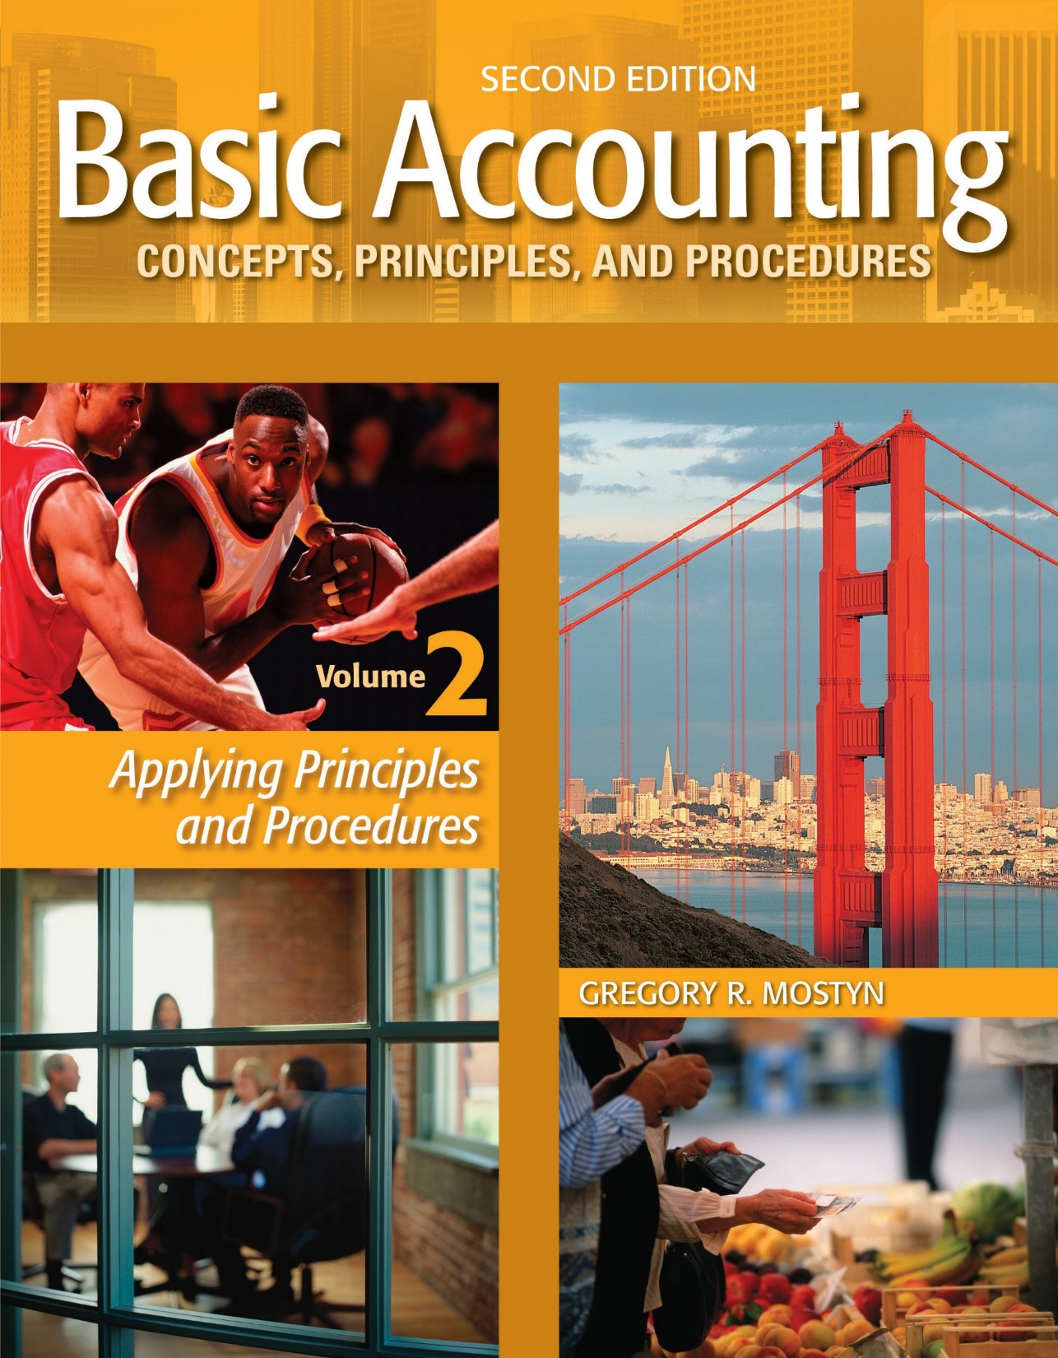
Basic Accounting Concepts Principles and Procedures, 2nd Edition, Volume 1
Basic Accounting Concepts Principles and Procedures, 2nd Edition, Volume 2

Slide 2
Learning Goal 9

Slide 3
The Complete Accounting Cycle
• The term accounting cycle refers to the recurring, sequential accounting
activities needed to record transactions, properly maintain accounting
records, and ultimately prepare financial statements.
• The next slide illustrates the stages of the full accounting cycle, which
we have now completed in our study of accounting.
• A worksheet is an optional tool that may be used as part of steps 4 -8.

Slide 4
1
Analyze
Documents
Recurring
Activity
During
Period
Process
2
Journalize
3
Post to ledger
4
Trial Balance
7
Communicate
5
Adjustments
Income statement
• Statement of owner's equity
• Balance sheet
• Statement of cash flows
Activity
at
End of
Period
6
Adjusted Trial Balance
8
Closing
9
Post-Closing
Trial Balance
Begin New Period

Slide 5
Review of the Components
• Analyze: This is always the initial step. It means reviewing documents
from an event, an analyzing potential the elements classification,
valuation, and timing, before the event is recorded as a transaction.

Slide 6
Review of the Components, continued
• Process: This is the bookkeeping process. It records and organizes transaction information in the accounting records.
• Journalize: Record transactions in a journal using debit and credit rules
• Post: Transfer amounts to ledger accounts using debit and credit rules.
• Trial balance: Prepare initial trial balance of non-zero accounts to prove
equality of debit and credit balances in ledger accounts.
• Adjusting entries: Journalize and post adjusting entries at end of period.
• Adjusted trial balance: Prepare trial balance of non-zero accounts to prove
equality of debit and credit balances in ledger accounts after adjustments.
• Closing: Journalize and post closing entries as of last day of period.
• Post-closing trial balance: Prepare trial balance of non-zero accounts to
prove equality of debit and credit balances in ledger accounts after
closing.

Slide 7
Review of the Components, continued
• Communicate: This is the preparation of financial statements and the notes
and analysis of the statements. The source of the financial statement
information is adjusted account balances. These are in the ledger or
worksheet.
The four required corporate financial statements are:
• Income statement
• Statement of Retained Earnings
• Balance Sheet
• Statement of Cash Flows

